Slide 1
SSH: Keys, Agents, & more
>_
Jaxon Haws

Slide 2

About Me
Just trust me bro
4th Year Computer Science
CPSEC:
  Sys-Admin: 2022-23
  President: 2021-22
CPLUG:
  Treasurer/Sys-Admin: 2022-23
  President: 2021-23
Experience: AMD, Jump Trading, Honeywell
Fun Fact: I just built my first gaming PC

Slide 3
Agenda
Did someone say bonus?
SSH Overview
What is an SSH key?
Key Types & Recommendations
How to generate keys
What is an SSH Agent?
How to set up an SSH Agent
Bonus SSH content

Slide 4
SSH Overview
The UNIX servers run OpenSSH 7.4p1 :(
ssh (secure shell):
  A program for logging into a remote machine and for executing commands on a remote machine.
  It is intended to provide secure encrypted communications between two untrusted hosts over an insecure network.
  ssh connects and logs into the specified destination, which may be specified as either:
    [user@]hostname
    ssh://[user@]hostname[:port]
  The user must prove their identity to the remote machine using one of several methods.

Slide 5
What is an SSH key?
Cryptographic key using a public key cryptosystem (RSA, DSA, ECC, etc)
Authentication credentials presented to a remote server, similar to a password

Slide 6
Key Types
Mmmm tasty bits
RSA & DSA
  RSA-4096
  RSA-3072
  DSA (1024 bits)
Elliptic Curve
  ecdsa
  ecdsa-sk
  ed25519
  ed25519_sk
  ecdsa (256, 384, 521 bits)
  ecdsa_sk

Slide 7
Key Recommendations
Real ones use ed25519_sk
Personal Recommendations
  ed25519
  ed25519_sk
  RSA-4096
  RSA-3072
Everything else
  dsa
  ecdsa
  ecdsa-sk
  RSA < 3072

Slide 8
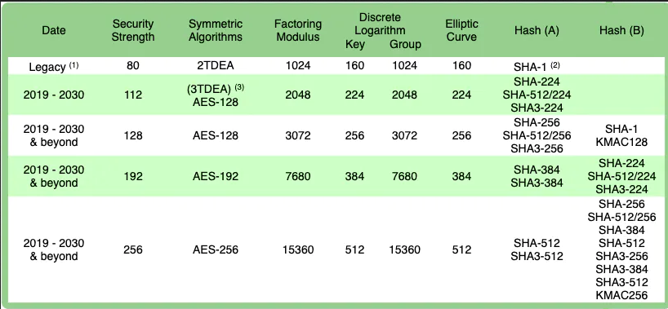
NIST Key Recommendations

Slide 9
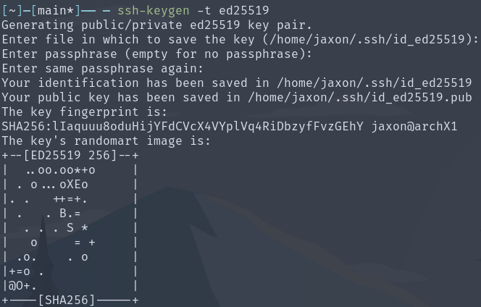
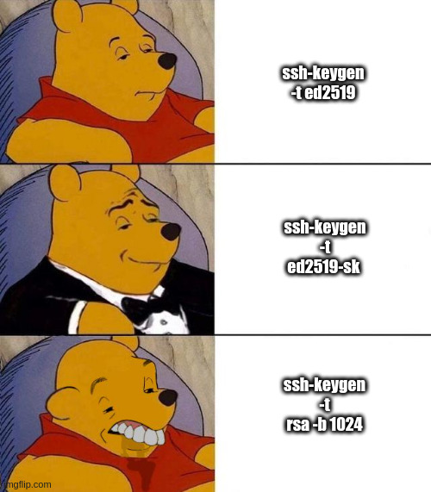
How to generate a key
Get that security out of my face

Slide 10
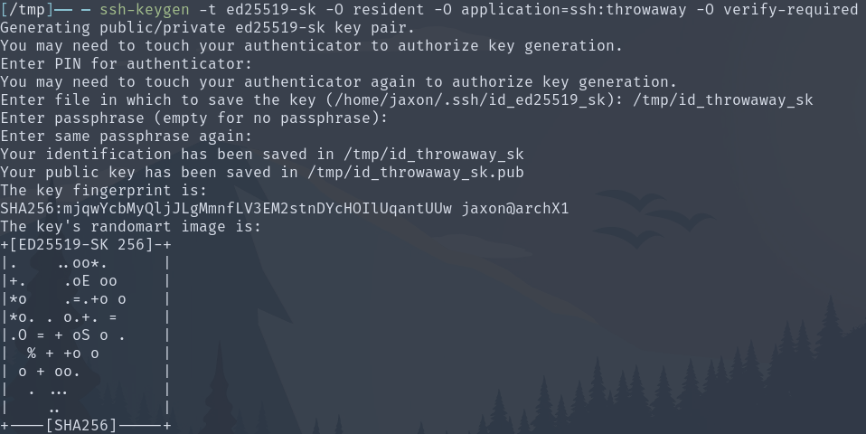
Generate a key on a YubiKey
I’ve always got my key
Discverable (Resident)
Requires OpenSSH >= 8.3 & YubiKey Firmware >= 5.2.3

Slide 11
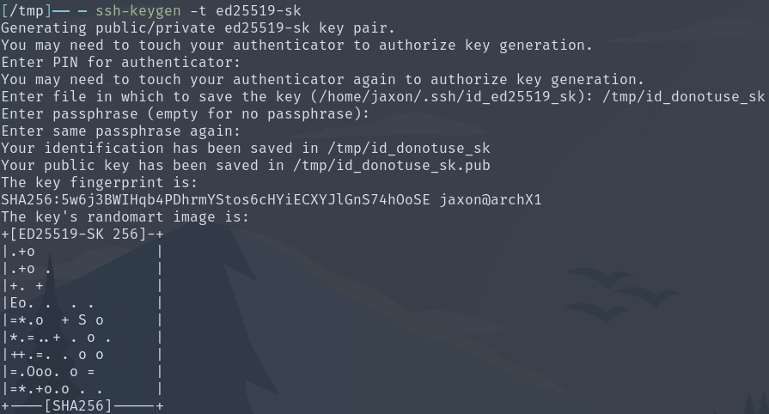
Generate a key with a YubiKey
My key requires a key
Non-Discverable
Requires OpenSSH >= 8.2p1 & YubiKey Firmware >= 5.2.3

Slide 12
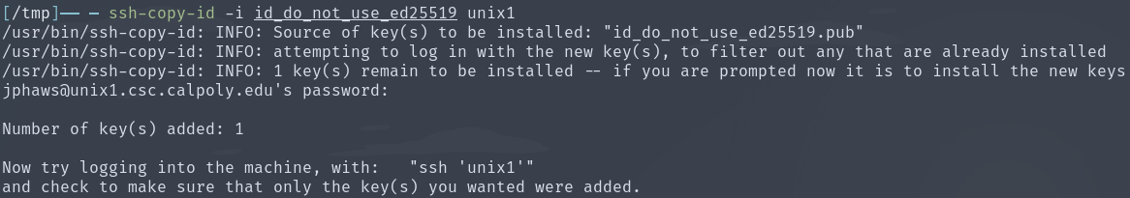
How to copy your key
How many doors do your keys open?

Slide 13
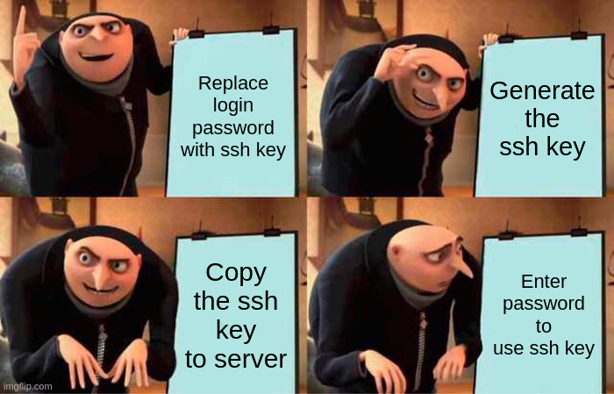
Security Best Practices
But passwords are hard...
1 key per unique host/application
Password protect your keys

Slide 14
What is an SSH Agent?
The step everyone ignores
ssh-agent:
  A program to hold private keys used for public key authentication.
  Through use of environment variables the agent can be located and automatically used for authentication when logging in to other machines using ssh(1).

Slide 15
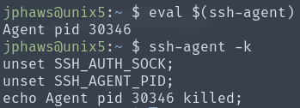
How to set up an SSH agent
A question as old as time

Slide 16
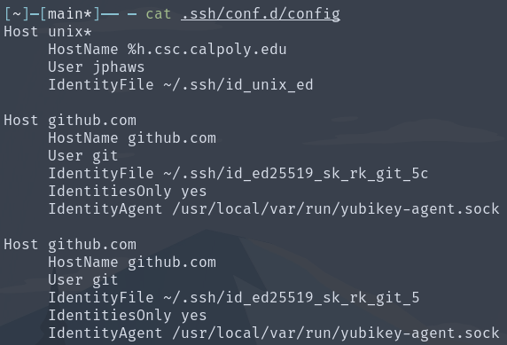

Bonus 1: SSH Config
Now featuring my ssh config file

Slide 17
Bonus 2: SSH tools
git push --force-with-lease
scp
git
Putty
Teleport

Slide 18
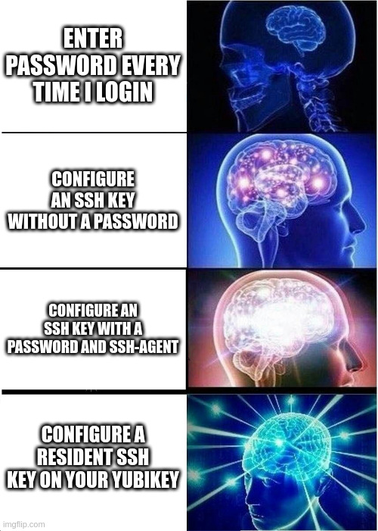
Bonus 3: Galaxy Brain SSH Keys

Slide 19
Resources
Who knew the man pages were so useful...
man ssh-keygen
man ssh-copy-id
man ssh-agent
man ssh-add
man ssh
https://goteleport.com/blog/comparing-ssh-keys/
https://wiki.archlinux.org/title/SSH_keys
https://developers.yubico.com/SSH/Securing_SSH_with_FIDO2.html

Slide 20
>_ exit
logout
Connection to Jaxon closed.
Thanks for watching

